Slide 1
Pelvis Practice
Take out your notes from yesterday. We are going to “add on” a bit w/ some pelvic identification practice

Slide 2
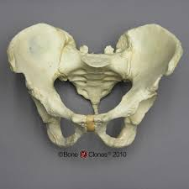
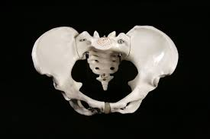
For each picture:
ID male or female with 2 justifications.
1.
Male
2.
Female

Slide 3
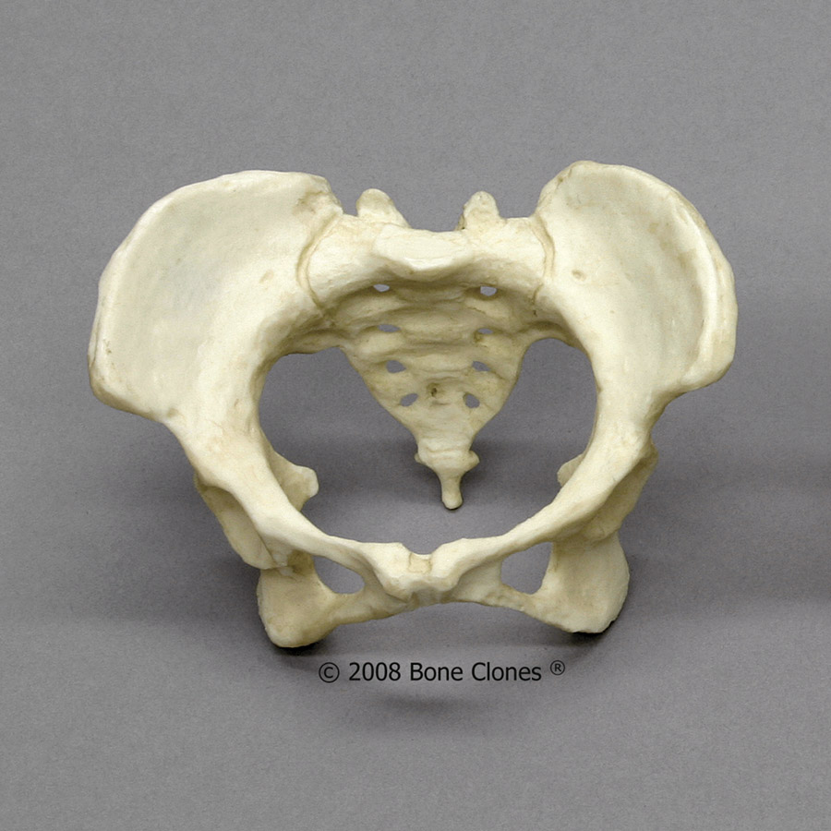
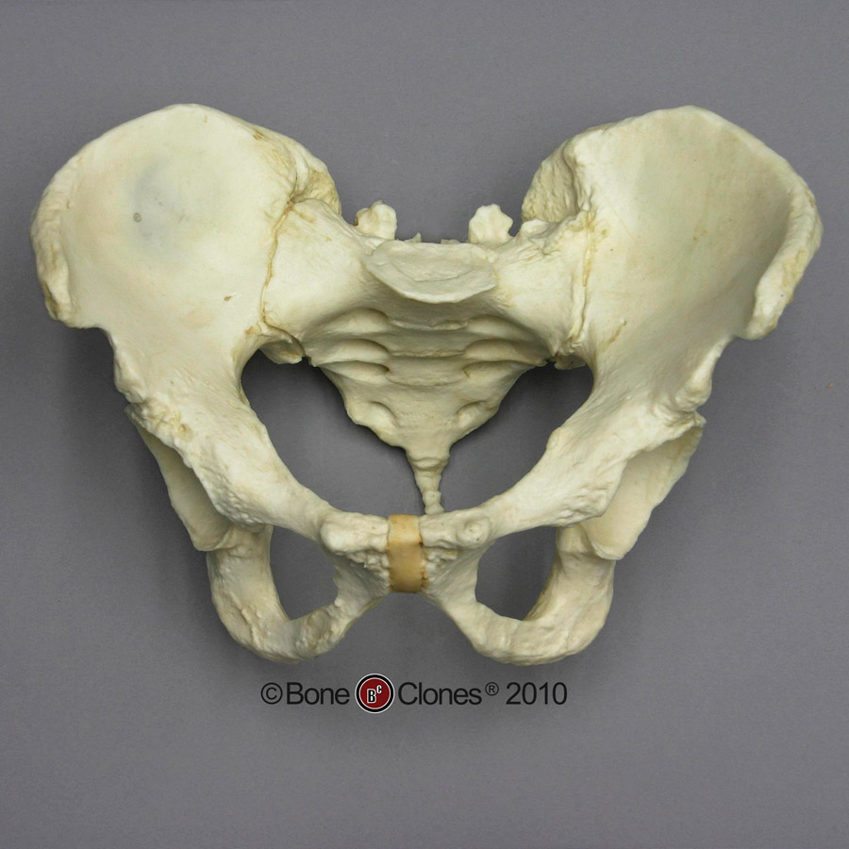
3.
Female
4.
Male

Slide 4
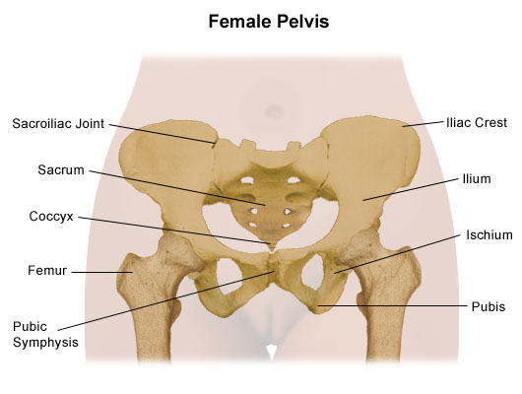
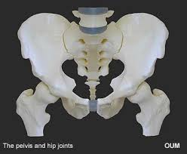
5.
Female
6.
Male

Slide 5
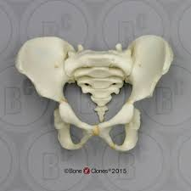
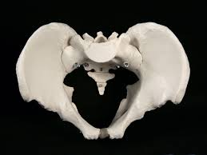
8.
Male
7.
Male

Slide 6
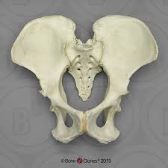
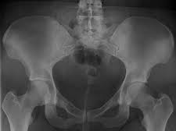
9.
Female
10.
Female

Slide 7
IX. Determining Sex w/ Skull
SKULL | MALE | FEMALE
1. External Occipital Protuberance
2. Supra Orbital Ridges (Eyebrows)
3. Mastoid Process
4. Mandible
5. Forehead Angle
“Shelf” is visible/present
No shelf
Pronounced
Flat/non-existent
Rounded, larger
Pointier, smaller
≈ 90°
> 90°, obtuse
(Jaw)
Slanted
Vertical

Slide 8
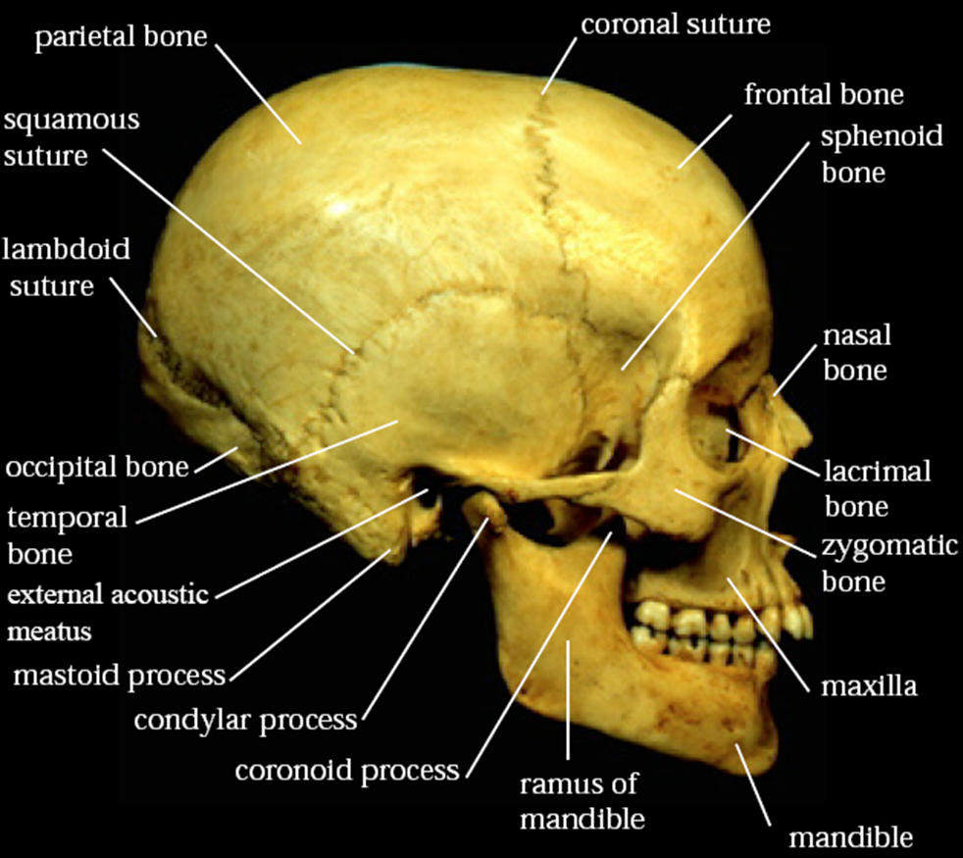
A. Analyzing the Skull (~ 90%)
5. Forehead angle
2. Supra orbital ridges
1.External occipital protuberance
3. Mastoid process
4. mandible

Slide 9
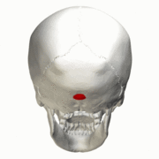
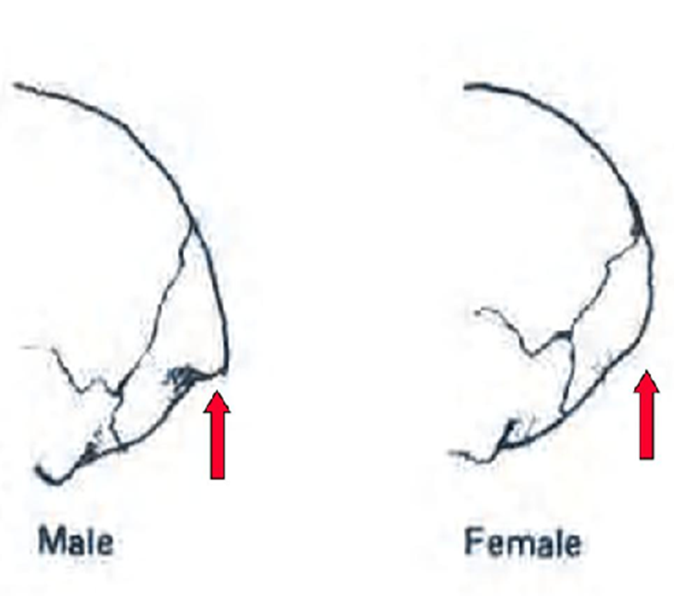
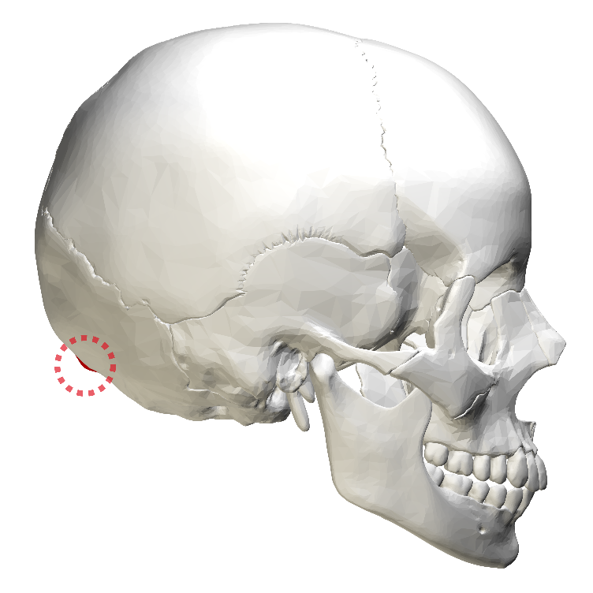

Slide 10
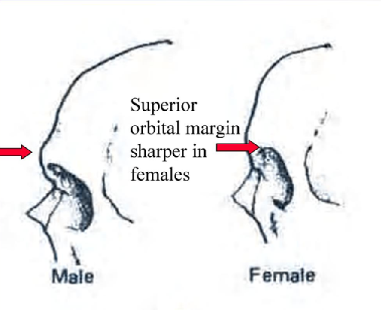
Supraorbital ridges
This is the region directly above the orbit and nose, or the "brow ridge“.
Less pronounced=female
More pronounced=male

Slide 11
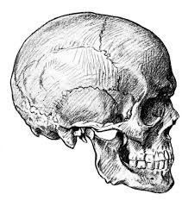
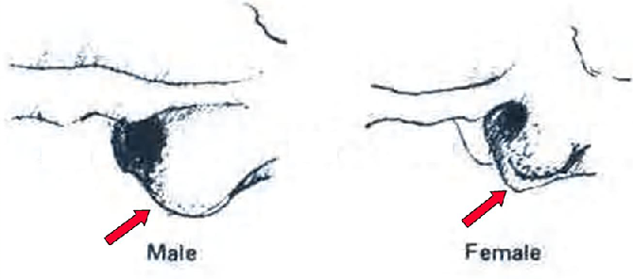
MASTOID PROCESSES

Slide 12
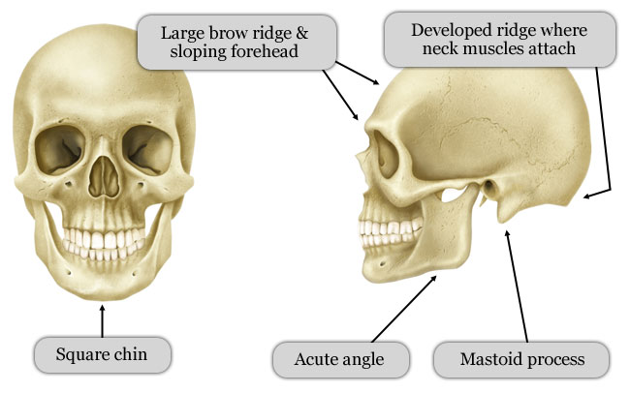
MANDIBLE (Jaw Angle)

Slide 13
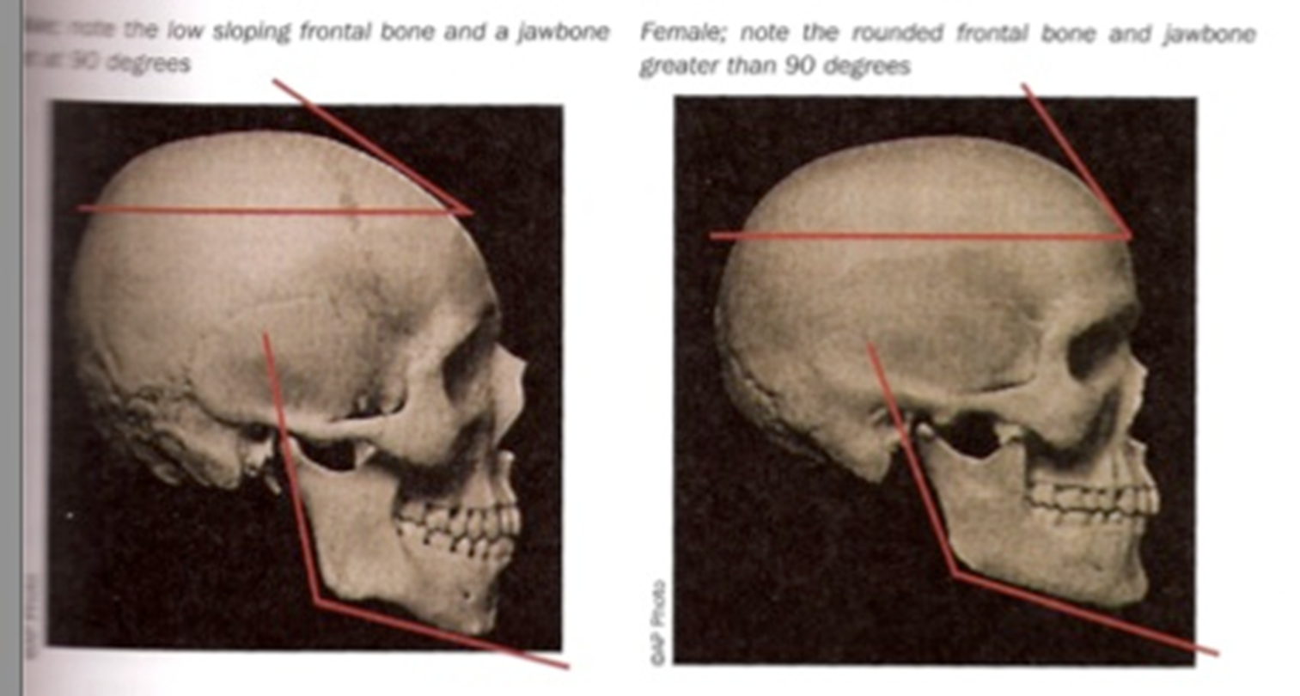
5. Forehead Angle

Slide 14
Skull Practice
Take out your notes from Friday. We are going to “add on” a bit w/ some skull ID practice

Slide 16
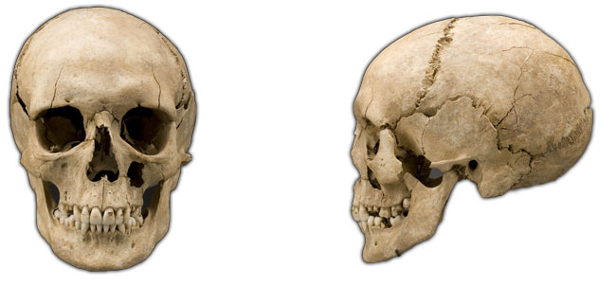
Skull Practice:
Male or female - give 2 justifications
1.
Female

Slide 17
male
2.
3.
female

Slide 18
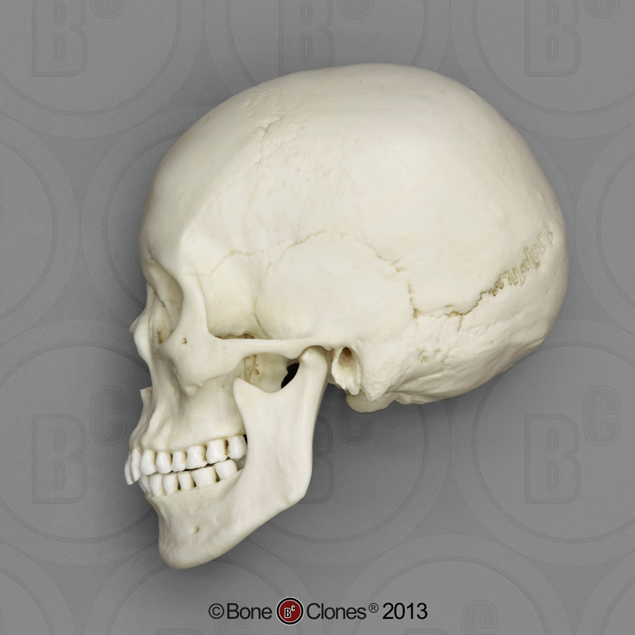
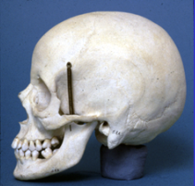
4.
Female
5.
Female

Slide 19
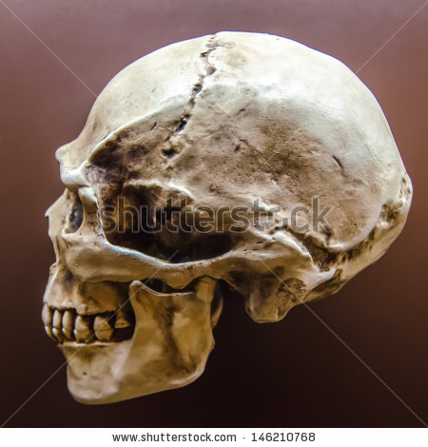
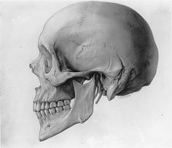
6.
Male
7.
Female

Slide 20
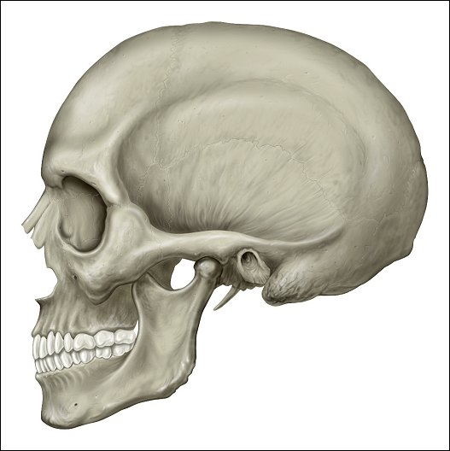
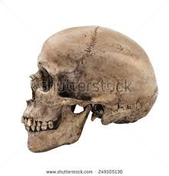
8.
Male
9.
Male

