Slide 1
Lab: Blood Drops - Height vs. Diameter
Drop Height | Diameter (mm)
1.) 1 inch
2.) 2 inches
3.) 6 inches
4.) 12 inches
5.) 24 inches
6.) 5 feet (1.542 meters)
7.)
8.)
9.)
Choose your own height*
Choose your own height*
Choose your own height*

Slide 2
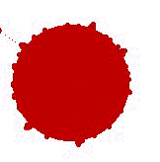
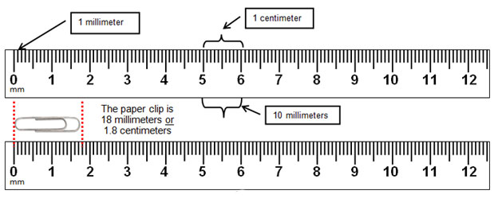
Measure the diameters in millimeters…
24 in. drop height
Make sure you let the blood dry BEFORE you measure the diameter!!

Slide 3
Analysis Questions
Do not copy the questions!!
1.) Using this lab, identify four vocab terms that were discussed in the Blood Spatter Vocab Voyage.
2.) The blood spatter in this lab would be classified as (choose one):
A.) low impact spatter
B.) medium impact spatter
C.) high impact spatter
3.) Which of your nine heights created the blood drop with the largest diameter?
4.) How does the distance from the target affect the diameter of the blood drops?
5.) What steps of the lab procedure could be changed to increase the diameters of the blood drops for any height in this lab? (i.e. “How could we make the diameters larger from all heights?”)
6.) What shape does a drop of blood have as it is falling to the ground?
7.) How does the shape of the blood drop change as it comes into contact with the target?
8.) Did the angle of impact change or stay the same as you changed heights?

