Slide 1
Lab: Bite Marks
Materials:
½ of a Styrofoam plate
Scissors
Pen
Ruler
Paper Towel

Slide 2
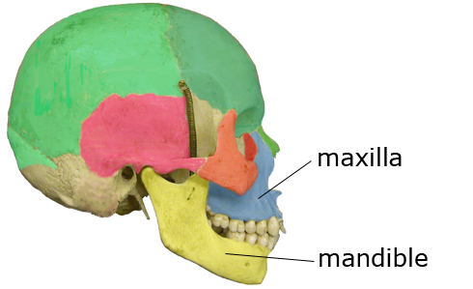
Procedure:
Each student needs one half of a styrofoam plate
Cut TWO “rectangular” pieces using your half plate.
Label one maxilla (top) and one mandible (bottom) with a pen.
Put both of the Styrofoam rectangles as far back into your mouth as possible so you can get an impression of your molars too!!
Bite down firmly!! (but DON’T bite through!)
Rinse off your impressions in the sink with soap!!!!!!!!!
Set them on a paper towel to analyze.

Slide 3
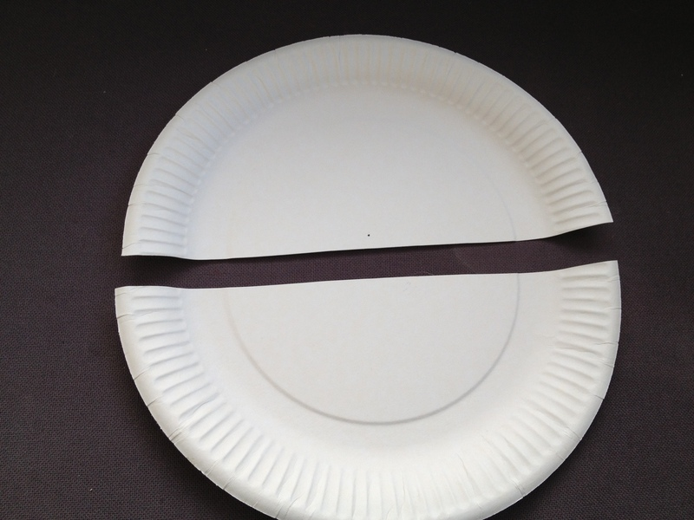
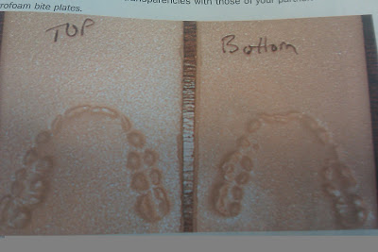
Dental Impressions Set-Up
Student A
2.)
1.)
Student A
Student B
3.)
Maxilla
Mandible
Student B

Slide 4
Post Lab Analysis:
Copy this chart and fill in ALL of the measurements below.
Identify at least 5 unique areas on your maxilla and mandible.
Identify at least 2 unique individual characteristics between you and a friend.
Throw away your bite mark impressions!
 | Maxilla (Mx) Top | Mandible (Mn) Bottom
Width of outside back molars | mm | mm
Width of inside back molars
Distance b/w Canines
Choose 3 measurements of your own!
Choose your own!
Choose your own!

Slide 5
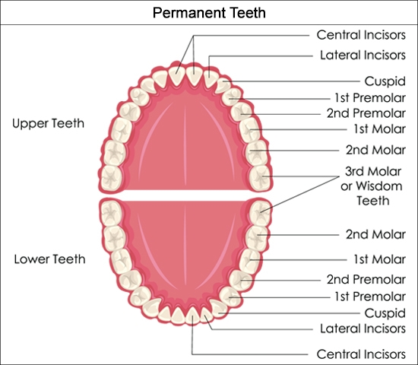
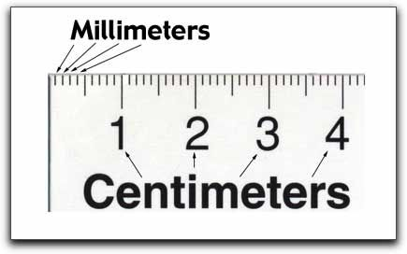
Human Teeth

Slide 6
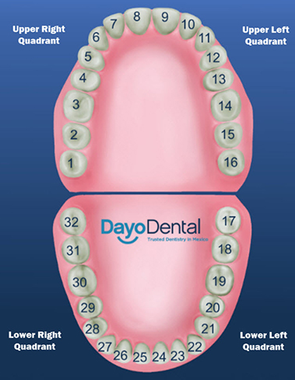
Tooth Number Chart
EVIDENCE:
Tooth Rotation
Arch Width
Dental Work
Wear Patterns
*Mx = Maxilla (top)
*Mn = Mandible (bottom)

